Slide 1
Amazon EventBridge
Lecturer: Ngo Huy Bien
Software Engineering Department
Faculty of Information Technology
University of Science
Ho Chi Minh City, Vietnam
nhbien@fit.hcmus.edu.vn

Slide 2

Objectives

Slide 3

Contents

Slide 4

References

Slide 5
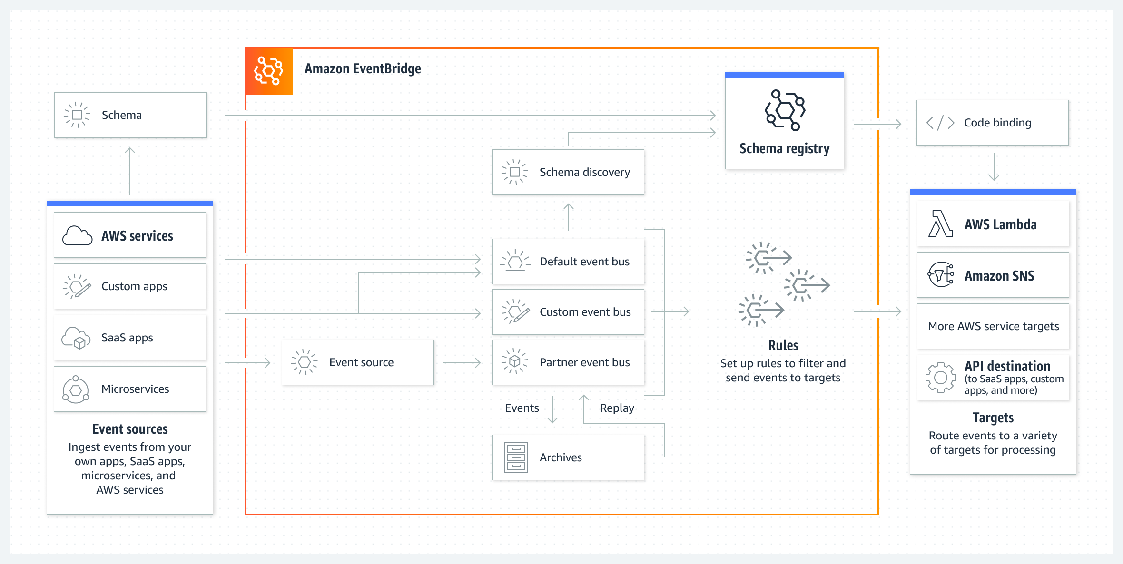
Amazon EventBridge
https://aws.amazon.com/eventbridge/
Amazon EventBridge Event Bus is a serverless event bus that helps you receive, filter, transform, route, and deliver events.

Slide 6
EventBridge vs. SNS
You can use both Amazon EventBridge and Amazon Simple Notification Service (Amazon SNS) to develop event-driven applications.
EventBridge is suitable with an application that reacts to events from software as a service (SaaS) applications or AWS services.
EventBridge is the only event-based service that integrates directly with third-party SaaS AWS Partners.
EventBridge uses a defined, JSON-based structure for events, and you can also select events to forward to a target by creating rules that are applied across the entire event body.
EventBridge has limited throughput, which can be increased on request. It also has a typical latency of about half a second.
SNS provides nearly unlimited throughput. You can also use it for applications that need very high fan-out (thousands or millions of endpoints). Messages are unstructured and can be in any format.

Slide 7
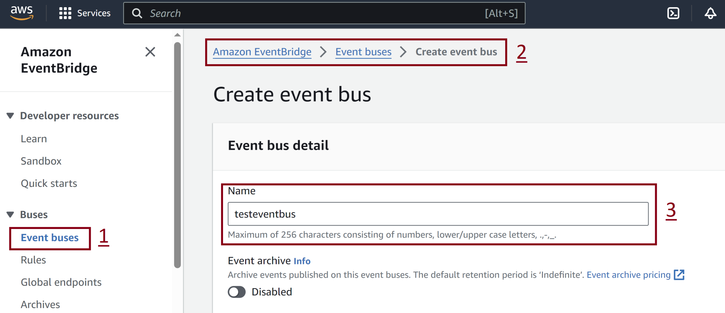
1. Create Event Bus

Slide 8
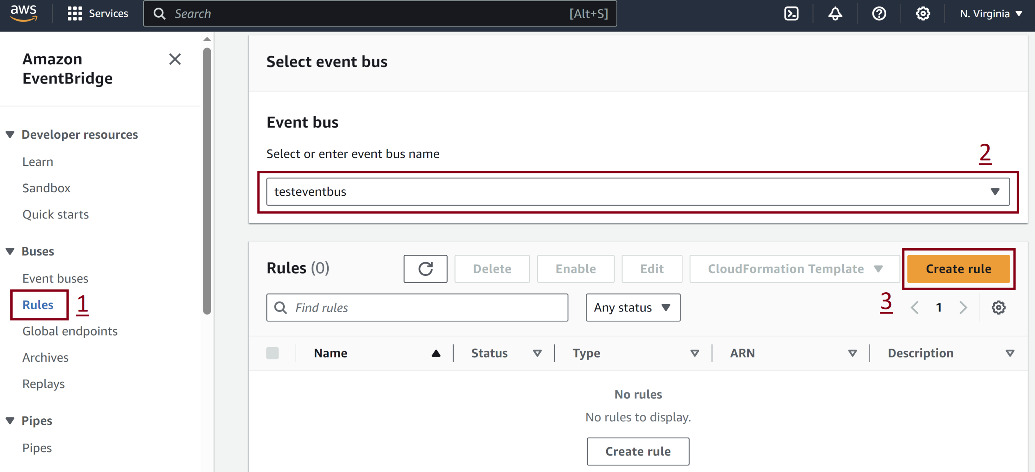
2. Create Rule

Slide 9
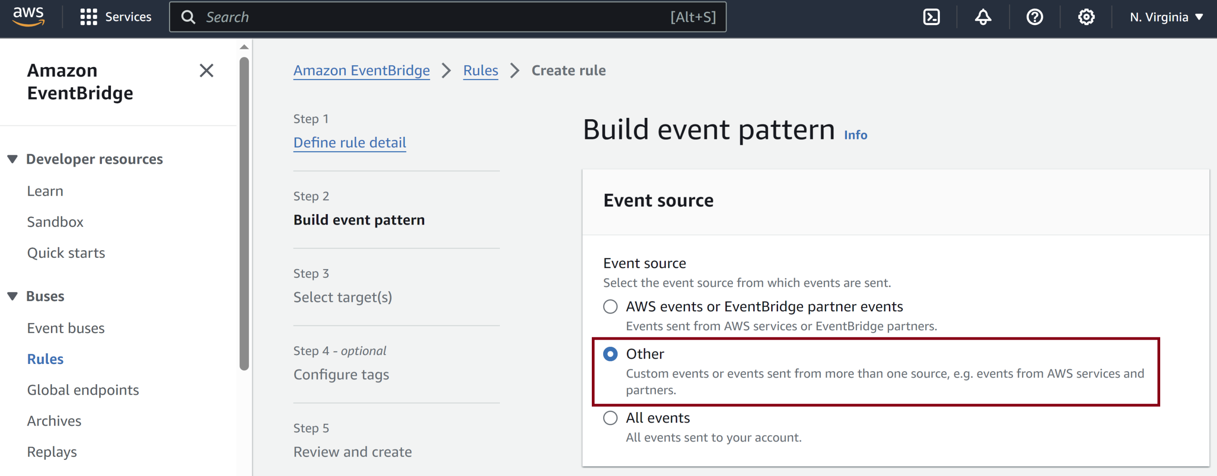
3. Select Rule Event Source

Slide 10
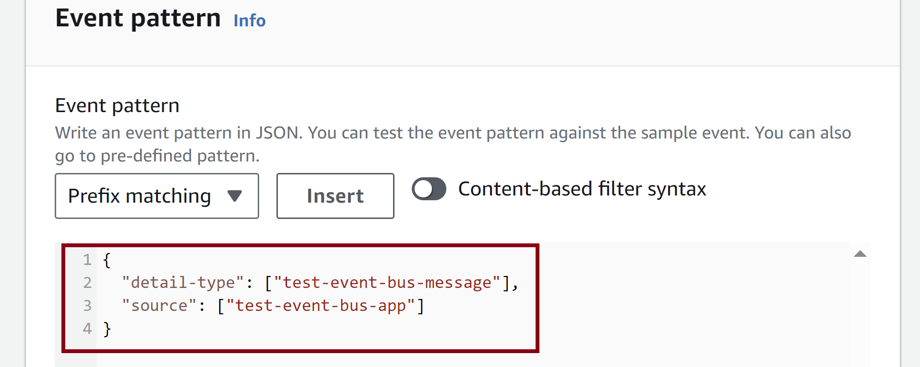
4. Enter Rule Event Pattern

Slide 11
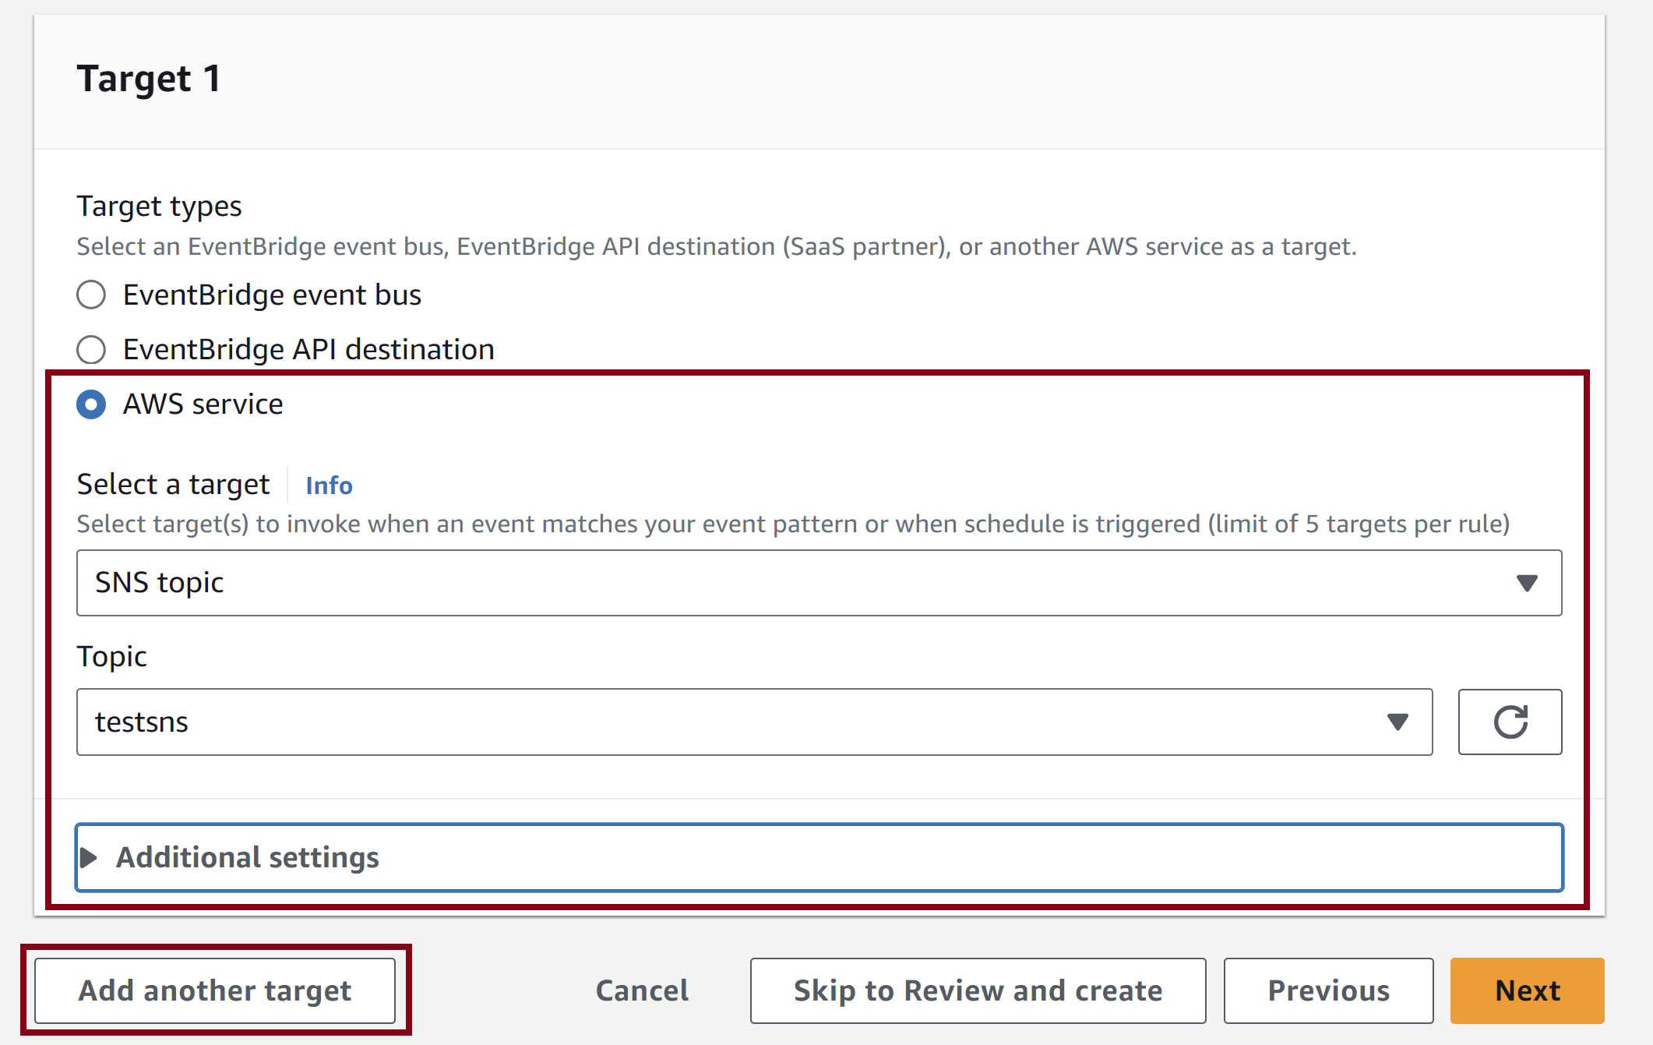
5. Add Target

Slide 12
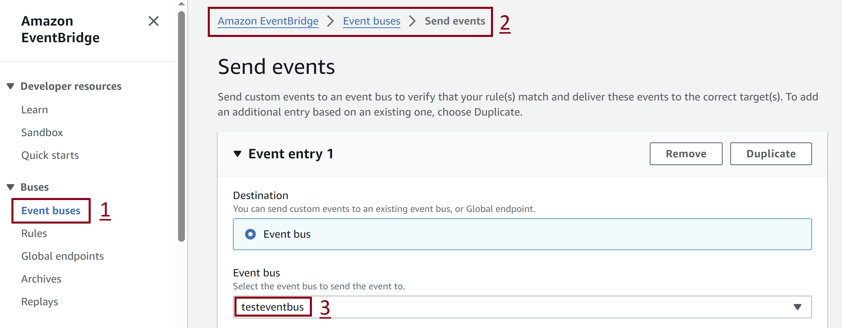
6. Send Event

Slide 13
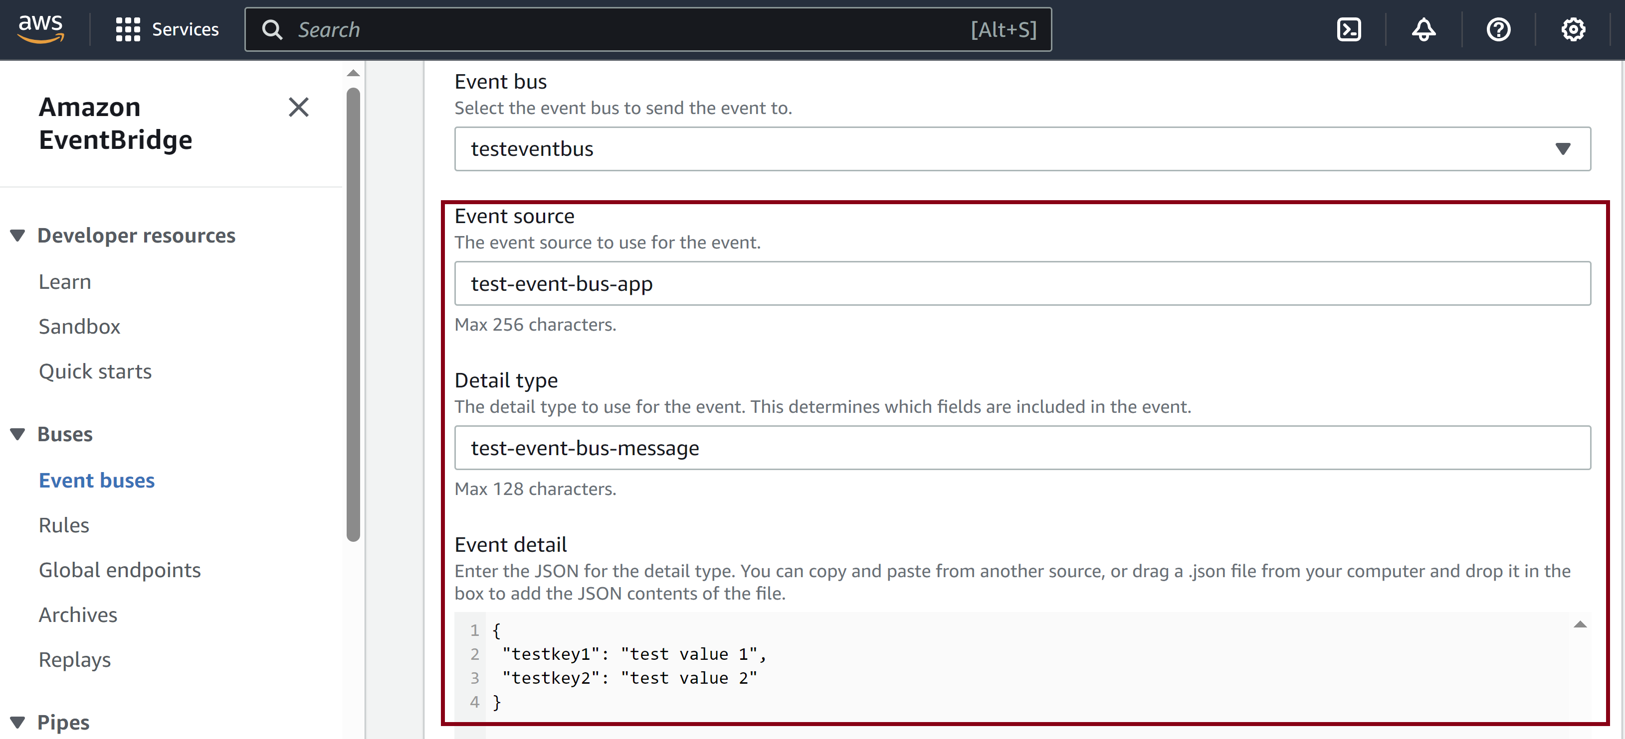
7. Enter Event Info Matching a Rule

Slide 14


Slide 15
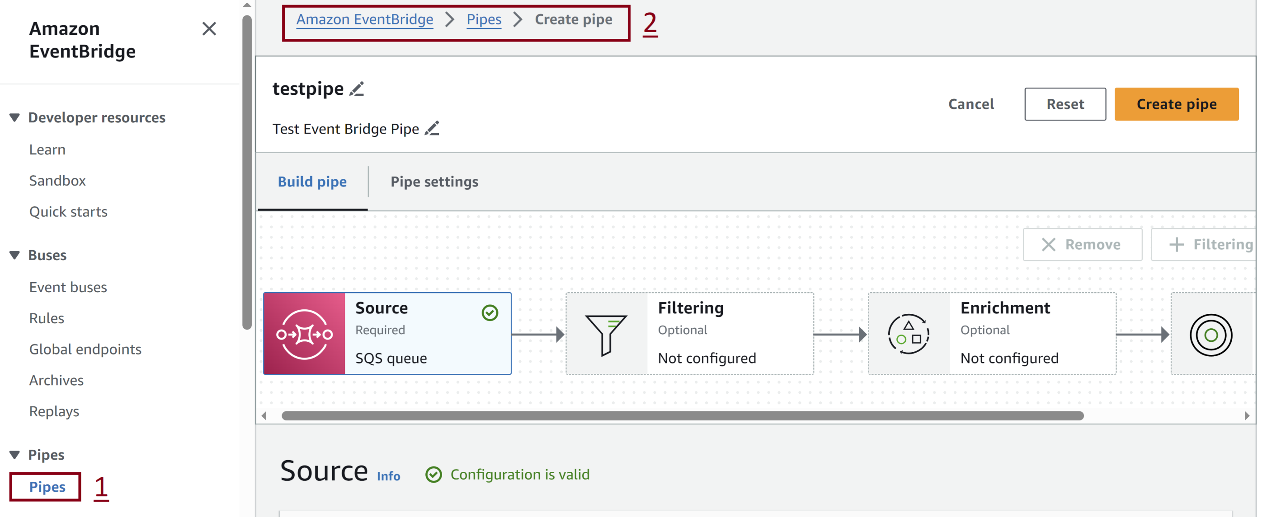
1. Create Pipe

Slide 16
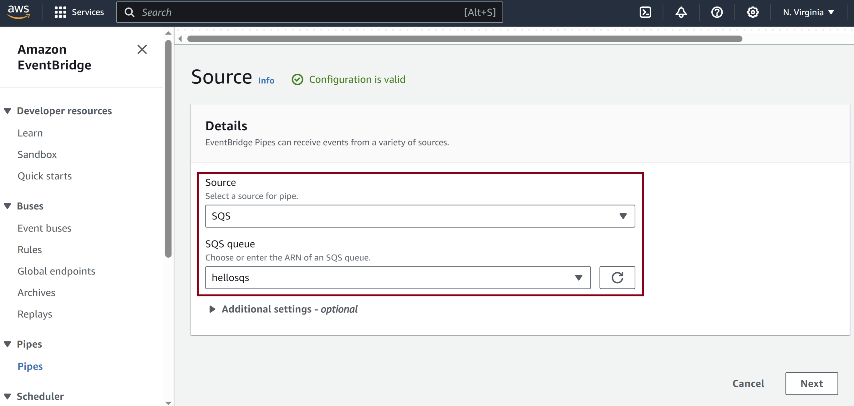
2. Select Pipe Source

Slide 17
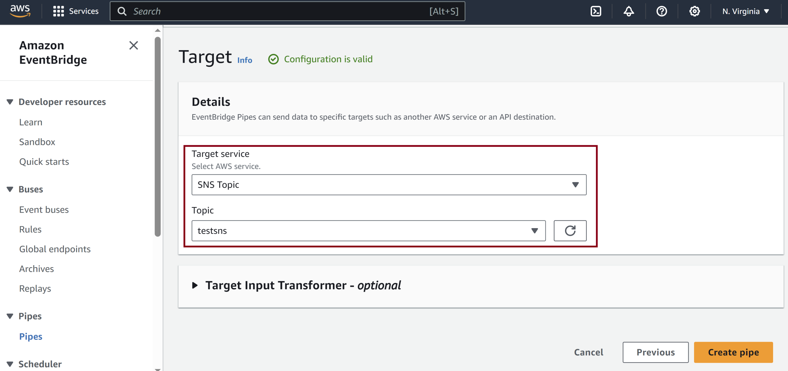
3. Select Pipe Target

Slide 18
4. Send Message
import boto3
import json
def send_message():
sqs_client = boto3.client("sqs", region_name="us-east-1")
message = {"key": "value"}
response = sqs_client.send_message(
QueueUrl="https://sqs.us-east-1.amazonaws.com/135319629286/hellosqs",
MessageBody=json.dumps(message)
)
print(response)
send_message()

Slide 19

Thank You & See You Again

